Slide 1
Lit Elements pt 6 – CSS Grid
Encapsulated, single-responsibility, reusable code

Slide 2

Contents
Organizing lit elements with CSS Grid
Using CSS Grid inside a lit element

Slide 3
Organizing lit elements with CSS Grid
We can encapsulate functionality within Lit elements
We still need to organize these elements
How can we use CSS Grid for this

Slide 4
CSS Grid example
We want to create a layout using CSS Grid that
Has a header on top
A navigation and two elements in the middle
A footar at the bottom
We’ll be using plain html

Slide 5
CSS Grid example
Desired layout
header
nav
left
right
footer

Slide 6
CSS Grid example
.container { display: grid;
grid-template-columns: 1fr 2fr 2fr;
grid-template-rows: 1fr 3fr 1fr;
gap: 0px 0px;
grid-auto-flow: row;
grid-template-areas:
"header header header"
"nav left right"
"footer footer footer";
}
.header { grid-area: header; }
.footer { grid-area: footer; }
.nav { grid-area: nav; }
.left { grid-area: left; }
.right { grid-area: right; }
index.html
<div class="container">
<div class="header"></div>
<div class="footer"></div>
<div class="nav"></div>
<div class="left"></div>
<div class="right"></div>
</div>
index.css
This is FEP1 knowledge…

Slide 7
CSS Grid lit example
We want to use this same layout, but now using lit elements in stead of <div> elements.
Replace the <div> elements in the example with
<my-header>
<my-nav>
<my-left>
<my-element>
<my-footer>
All Lit elements
The demo lit element from the vite template

Slide 8
CSS Grid lit example
Desired layout
<my-header>
<my-nav>
<my-left>
<my-element>
<my-footer>
Lit elements

Slide 9
CSS Grid lit example
<div class="container">
<my-header class="header" title="My cool header"></my-header>
<my-footer class="footer" title="My cool footer"></my-footer>
<my-nav class="nav" title="my cool nav"></my-nav>
<my-left class="left" title="left"></my-left>
<my-element class="right">
<h1>Vite + Lit</h1>
</my-element>
</div>

Slide 10
import { LitElement, css, html } from 'lit'
export class MyHeader extends LitElement {
static get properties() {
return {
title: { type: String }
}
}
constructor() {
super();
this.title = 'untitled’;
}
render() {
return html`<h1>${this.title}</h1>`
}
static get styles() {
return css`
:host {
background-color: #e8f5d8;
text-align: center;
}`
}
} window.customElements.define('my-header', MyHeader)
code for <my-nav>, <my-left>, <my-footer> is identical
Only the colors differ!

Slide 11
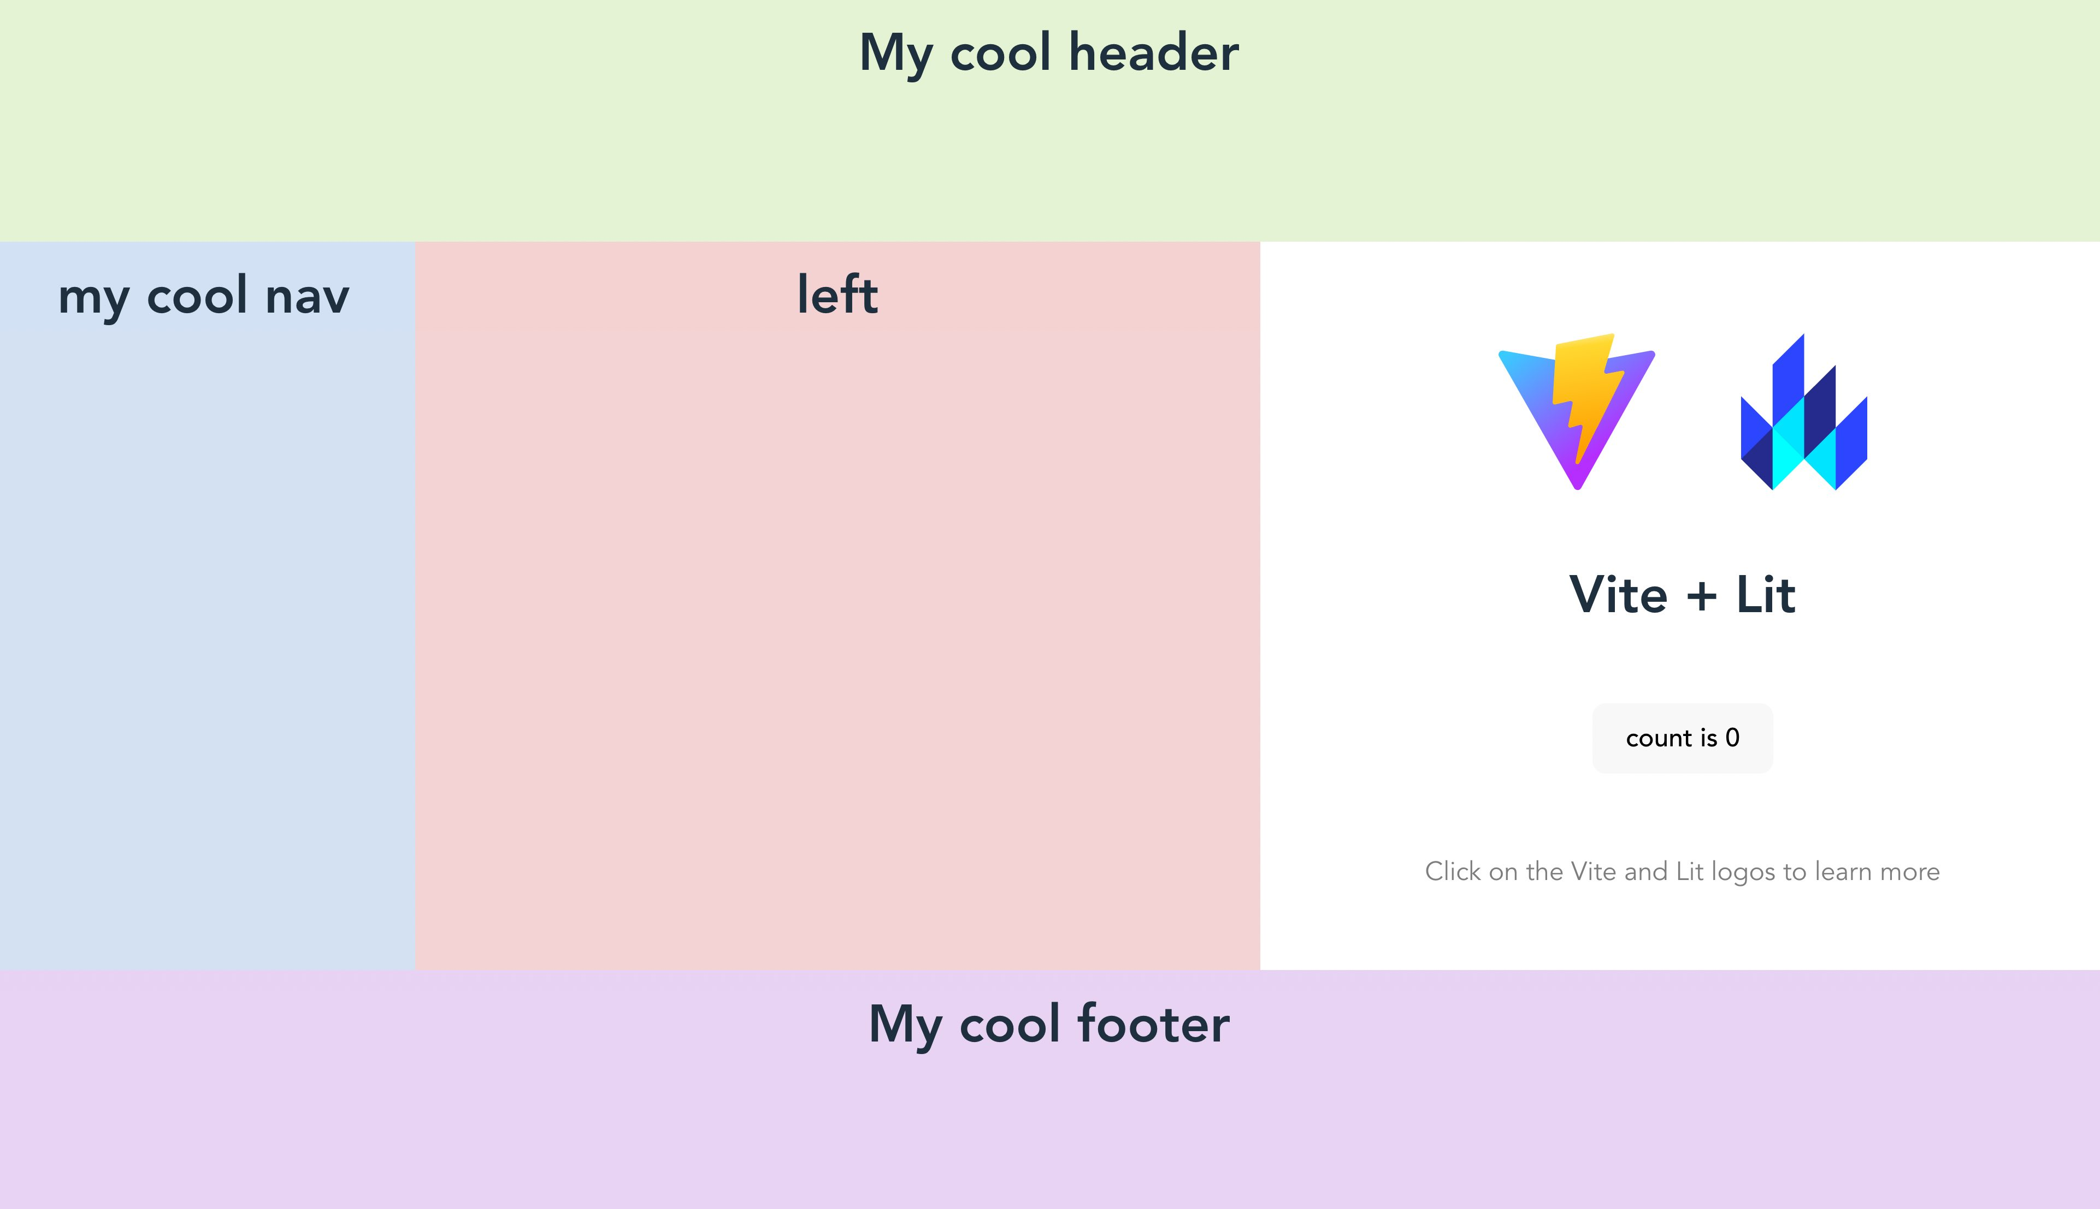
<my-header>
<my-element>
<my-left>
<my-nav>
<my-footer>

Slide 12
Organizing lit elements with CSS Grid
Organizing lit elements with CSS Grid is no different then organizing standard elements with CSS Grid
This should be no surprise (why?)

Slide 13
Using CSS Grid inside a lit element
A Lit element uses standard CSS styling
Can we also use CSS Gris inside a lit element?

Slide 14
CSS Grid example2
We’ll use the same layout as before
the <my-left> element html and css will be expanded to use a CSS Grid

Slide 15
CSS Grid example2
Desired layout
<my-left> will get a CSS Grid layout
top
left
mid
right

Slide 16
static get styles() {
return css`
:host {
background-color: #f5d8d8;
text-align: center;
}
.container {
display: grid;
grid-template-columns: 1fr 1fr 1fr;
grid-template-rows: 1fr 3fr;
gap: 0px 0px;
grid-auto-flow: row;
grid-template-areas:
"top top top"
"left mid right";
}
.top { grid-area: top;}
.left { grid-area: left; background-color: black;}
.mid { grid-area: mid; background-color: red;}
.right { grid-area: right; background-color: green;}`
}
in my-left.js
top, left, mid & right
top, left, mid & right

Slide 17
in my-left.js
render() {
return html`
<div class="container">
<div class="top"><h1>${this.title}</h1></div>
<div class="left">
<img src="./src/assets/cat1.jpg" alt="Cat" width="100" height="100">
</div>
<div class="mid">
<img src="./src/assets/cat2.jpg" alt="Cat" width="100" height="100">
</div>
<div class="right">
<img src="./src/assets/cat3.jpg" alt="Cat" width="100" height="100">
</div>
</div>
`
}
top, left, mid & right
This is added

Slide 18
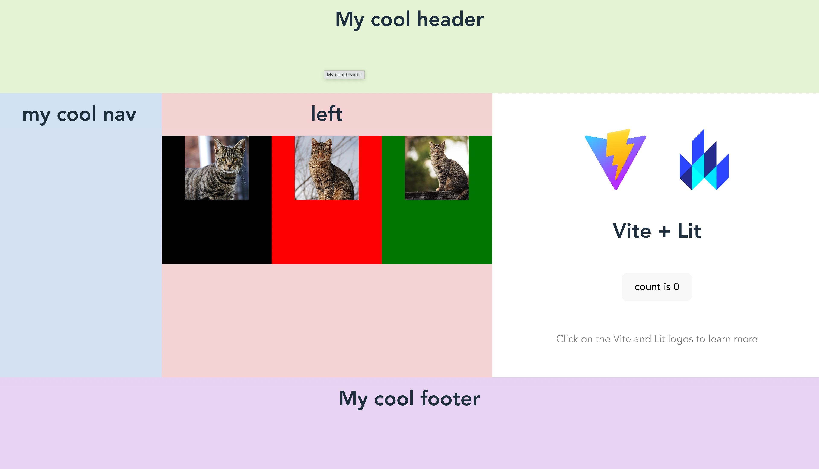
top
left, mid & right

Slide 19
Using CSS Grid inside a lit element
This demonstrates you can have a CSS Grid inside a CSS Grid
Web components / Lit elements can use CSS Grid for their internal layout and still be a part of a larger CSS Grid
Since you can nest Web components / lit elements
… (you get where this is going?)

Slide 20
Documentatie
Lit website:
https://developer.mozilla.org/en-US/docs/Web/CSS/CSS_Grid_Layout

Slide 21
Conclusion
Web components / Lit elements can bu used in CSS Grid just like any other html element
Web components / Lit elements can use CSS Grid for their internal layout
Which may consist of other components/elements

